Slide 1
Advanced Software:
Arrays & Classes
Cooper Union Summer STEM - Robotics Crash Course

Slide 2
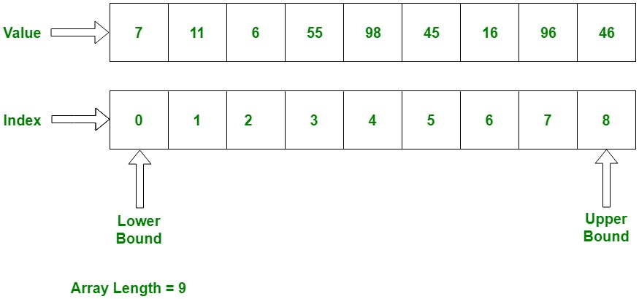
What is an Array?
An array is a series of elements of the same type placed in contiguous memory locations that can be individually referenced by adding an index to a unique identifier.
Arrays are declared with type name[length]

Slide 3
Working With Arrays
You can initialize an array to certain values with: int arr[3] = {1,2,3};
To access a value in an array use array_name[index];
So using the array above, arr[0] → 1, arr[1] → 2, arr[2] → 3
REMEMBER: Arrays begin with index 0!
You can modify a value in an array by just setting it equal to a new value: Arr[1] = 7 would make the array {1,7,3}

Slide 4
Loops: The While Loop
Loops repeat a certain block of code until the specified condition is satisfied.
The simplest loop is the while loop: while (condition) { statement }

Slide 5
Loops: The For Loop
The while loop is nice, but a majority of the time you will want to do something similar to this: int i = 1; while (i <= 10) { cout << i; cout << arr[i]; i++; }
Luckily, since it is so common, there is a loop to help us with that.

Slide 6
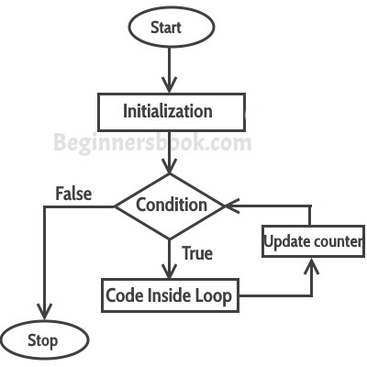
Loops: The For Loop Continued...
The for loop allows us to initialize variables and increment them within the loop header. for (initialization; condition; update variable) { statement }

Slide 7
Practice with Arrays
Open “Indiv Work Templates” → “Array_Task_1”
Create an array of type int with size 10.
Using a while loop, fill the array with all multiples of three between 3 and 30 (inclusive).
Rewrite #2 with a for loop.
Write a loop that will go through the array and print any values that are a multiple of 9. Hint: use the % operator.

Slide 8
More Practice With Arrays
Open “Array_Task_2”
Fill in the findMax( ) function. It should take an array and return the largest value in the array.
Fill in the findMin( ) function. It should take an array and return the smallest value in the array.

Slide 9
What is a Class?
A class is a user-defined data type, which holds its own data members and member functions, which can be accessed and used by creating an instance of that class.
A class is like a blueprint for an object. An object is an instantiation of a class.
Classes are used for many reasons: 1. You have a specific data-structure that you want to reuse. 2. You have information that you want to remain private.

Slide 10
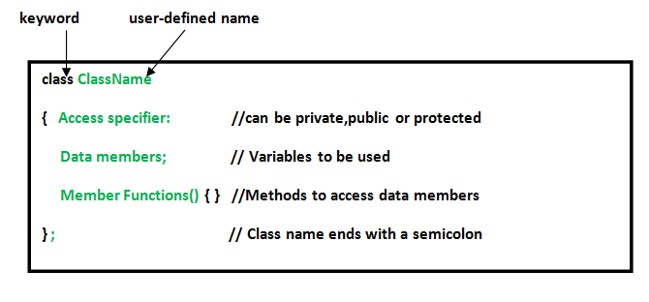
Defining Classes

Slide 11
Using Classes
You can instantiate a class with: Classname object_name
You can access variables and functions within a class using the dot operator (or a period): object_name.variable_name object_name.function_name()

Slide 12
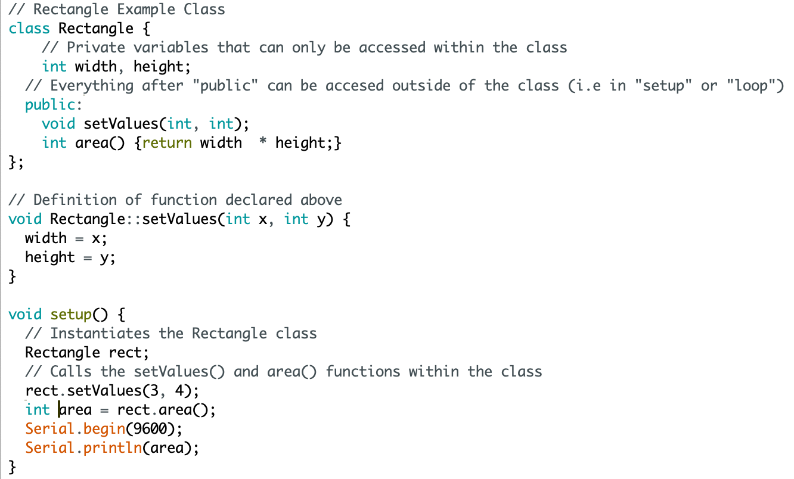
Example Class

Slide 13
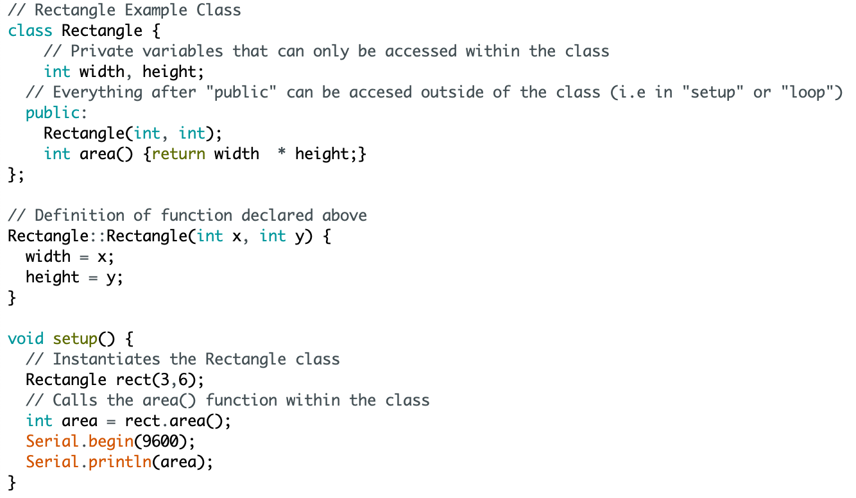
Constructors
Constructors are special class members which are called by the compiler every time an object of that class is instantiated.
Constructors have the same name as the class and no return type (not even void).

Slide 14
Practice With Classes
Open the Circle class in “Individual Work Templates”.
Using the Rectangle class for reference (it’s in “module material” → “arduino module” → “Advanced_Software”), fill in the following for the Circle class:
Private variables
Constructor
A function to return area
A function to update values
setup( ) function

